Slide 1
Dynamic Entrance Exam Performance Enhancement And Research
CONCEPT BY… Mr. Harish Butle

Slide 2

Let’s Take It One Step Further
Most Trusted Way To Know Your Estimated SML Before Entrance Exam

Slide 3
What is DEEPER…
is self reliant NGO.
working in the field of education to conduct Mock Tests of National (NEET / JEE- Main) and State (MHT-CET) Level entrance exams for last 14 years.
having representations of Principals & Teachers of Junior science colleges along with activists in Educational field.
DEEPER results act as a mirror to students to know their State Merit List. In last fourteen years ten deeper students are topper in Maharashtra state.
for three consecutive years in NEET, DEEPER toppers were state toppers indicating its accuracy by creating Hat-trick.

Slide 4
OBJECTIVES
1
to ensure that no one is deprived of quality education due to weak financial condition
2
to ensure that every deserving student gets platform to test his or her academic skills in NEET, JEE, MHT-CET
3
to make education cost effective so as to bridge a gap in terms of educational facilities
4
to enhance the results at state and national level by taking one step further for Preparation and Practice part to already existing Evaluation system.

Slide 5
Key Features
1
Most trusted
2
Acceptable
3
Reasonable
4
Result Oriented
5
Qualitative
6
Accurate
Popular
7
8
Reliable

Slide 6
Steps to reach the Goal
STEPS TO SUCCEED IN ENTRANCE EXAM
EVALUATE
PPE
PRACTICE
Key aspects of Deeper
PREPARE

Slide 7
PREPARE
COMING SOON …..
    NOTES
    SUBJECT BULLETIN
    AUDIO LECTURES
    VIDEO LECTURES
    ONLINE TUTORIALS
    PRESENTATIONS

Slide 8
PRACTICE
Mock tests with difficulty
Solving Sessions
5
ELEVENTH HOUR PREPARATION
15 days before Final Exam
4
FULL LENGTH TESTS (FLT)
11th & 12th Sci
3
CHAPTER WISE TESTS
11th & 12th Sci
2
TOPIC WISE TESTS
11th & 12th Sci
1

Slide 9
Evaluate -Spirit of Real Mock – 2021 and 2022
D
DCT
WAKE UP CALL
STD XII
K
KASAUTI
SWEEP UP STD XII
1
2
3
4
5
A
AARAMBH
GET STARTED
STD XI
M
MIRROR
GEAR UP
STD XII
Ready
to Face NEET, JEE,
MHT-CET

Slide 10
EXAMS AND SCHEDULE FOR 2020 -2021
Exam | Spirit | NEET | MHT- CET (PCM) | MHT-CET (PCB)
DCT | WAKE UP | 30th May 2021 | 06th June 2021 | 06th June 2021
MIRROR | GEAR UP | 27th June 2021 | 13th June 2021 | 13th June 2021
KASAUTI | SWEEP UP | 18th July 2021 | 11th July 2021 | 11th July 2021

Slide 11
OFFERS AND PACKAGES
FEE STRUCTURE
CHOICE | OFFLINE | ONLINE
 | NEET | MHT-CET/JEE
ANY ONE (D/M/K) | 500 | 300
ANY TWO (DM/DK/MK) | 900 | 500
ALL THREE (DMK) | 1200 | 700

Slide 12
EARLY BIRD CONCESSIONS 2st Oct – 31st Dec
CHOICE | OFFLINE | ONLINE
 | NEET | MHT-CET/JEE
ANY ONE (D/M/K) | 450 | 250
ANY TWO (DM/DK/MK) | 800 | 450
ALL THREE (DMK) | 1100 | 650
WITH LATE FEES 1st March – 30th April
CHOICE | OFFLINE | ONLINE
 | NEET | MHT-CET/JEE
ANY ONE (D/M/K) | 550 | 350
ANY TWO (DM/DK/MK) | 1000 | 600
ALL THREE (DMK) | 1300 | 800

Slide 13
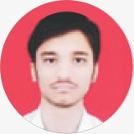
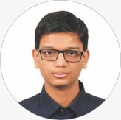
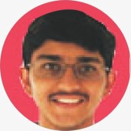
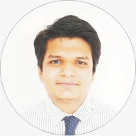
NEET RANKERS -2020
SCORE: 705 / 720
46th in India
4th in Maharashtra
4th in DEEPER
DEEPER EXAMS
DCT: 641/750 (Rank 3) MIRROR: NA
KASAUTI: 696/750 (Rank 4)
Abhay Chillarage
Rajashree Shahu College, Latur
Atharva Deo
Adv. Ram Sharma College,
Sadashiv Peth, Pune
SCORE: 700 / 720
73rd in India
DEEPER EXAMS
DCT: 677/750 (Rank 30)
MIRROR: 641/750 (Rank 23)
KASAUTI: 676/750 (Rank 19)
Rahul Kothari
IES College,
Bandra,Mumbai
SCORE: 700 / 720
92nd in India
DEEPER EXAMS
DCT: NA
MIRROR: 685/750 (Rank 1)
KASAUTI: 705/750 (Rank 2 )
Jayatra Shah
Prakash College,
Kandivali, Mumbai
SCORE: 700 / 720
110th in India
DEEPER EXAMS
DCT: 589/750 (Rank 23)
MIRROR: 634/750 (Rank 30)
KASAUTI: 672/750 (Rank 22)

Slide 14
MHT- CET TOPPERS 2020 WITH 100 PERCENTILE
NAME
STATE RANK
Saurabh Jog (Pune)
2
Vedant Jhoshi (Nanded)
3
Chaitya Vohra (Mumbai Upnagar)
5
Pranav Kute (Thane)
12
Kedar Dhumne (RSM, Latur)
15
Abhay Chillarge (RSM, Latur)
16
Pranav Tatapure (RSM, Latur)
17

Slide 15
For Teachers…..
Updating themselves with current trends related to subject
Self Development by subject Enrichment
4
1
Interaction with teachers of all over Maharashtra
Result enhancement of students and colleges
3
2

Slide 16
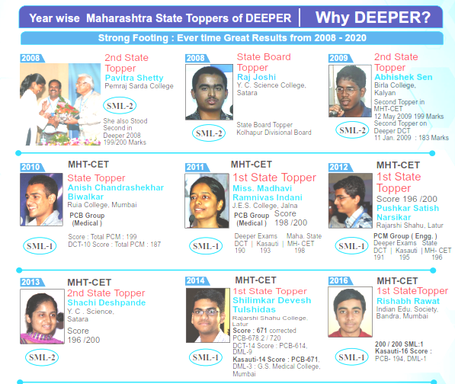
Achievements

Slide 17
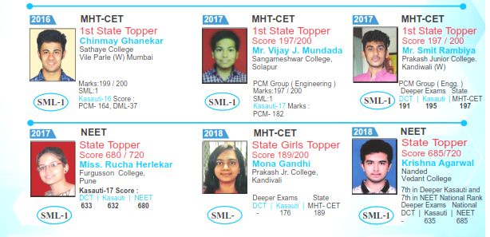
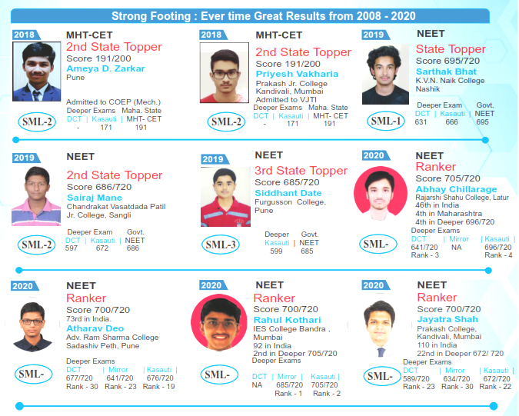

Slide 18
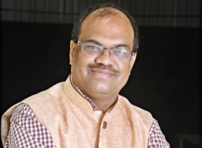
PROFILE OF Mr. HARISH BUTLE, FOUNDER
DEEPER is the brainchild of Harish Butle, a noted Social Entrepreneur,
Educationist and Social worker who believes each deserving student
must be given an equal opportunity and facility to compete in a fair manner.
Harish Butle - Founder and Brain behind the social concepts
Founder Secretary - DEEPER
Founder President - SIR Foundation
Editor- ‘Tumhi-Aamhi Paalak’ magazine
Founder & Managing Director - Saad Manuskichi Foundation
Founder President – Mahaexam
Founder President – Mahaparents
Conceptuliser – ‘Mahapalak’ and ‘Sansthapalak’ Sanman

Slide 19
Team DEEPER
Committees | No. of Members
Governing Council | 11
Executive Council | 21
Academic Council Committee | 21
Divisional Coordinator Committee | 9 + 2
District Coordinator Committee | 36 + 4
Academic Coordinator Committee | 36 + 4
District Committee members | 750
College Representatives | 1 per college

Slide 20
Board Of Directors
Prin.Dr. Kiran Mangaonkar (Mumbai) | President | 9833835824
Mr. Dilip K Deshmukh (Latur) | Executive President | 9422303120
Mr. Harish Butle (Pune) | Founder - Secretary | 9422001560
Prin. Mukund Andhalkar (Mumbai-U) | Vice President | 9821029372
Mr. Vitthal Gulhane (Pune) | Treasurer | 9960305643
Dr. Sanjay Shinde (Nashik) | Head Executive Council | 9422748427
Mr. Mayur Mehta (Mumbai) | Head Academic Council - Urban | 9322238784
Mr. Gurudas Vernekar (Akluj) | Head Academic Council - Rural | 9422463103
Mr. Raj Bhatt (Mumbai) | Head Academic Technical | 9892168497

Slide 21

THANKS!
For Any Queries:
www.deeper.org.in
201, Balkrushna Apts, 495, Narayan Peth,
Inside Gajanan Chaitanya Building, Near Patrya Maruti, Pune-411030
+ 91-20-2446 5885 + 91-860 500 9231
+91-860 500 9232 + 91-982 309 9663
deeperexams@gmail.com
Portal: safer.deeper.org.in
Social | Affordable | Fair | Excellent | Reasonable

